Slide 1


Game with Procedurally Generated Levels
By Tyler Smith

Slide 2
Overview
2D game from an overhead perspective
Escape from the cultist ghosts
Spooky, cartoony aesthetic
Level(s) are procedurally generated

Slide 3
Procedural Generation for Video Game Levels
Levels created by an algorithm rather than being hand crafted
Adds replay value
The Binding of Isaac and Darkest Dungeon

Slide 4






Tools

Slide 5
Development Process
Create a list of to-dos ordered by priority. Gameplay first, aesthetics and story last.
Development Schedule
February: Research and early development (build basic gameplay system with basic assets and start creating rooms for levels).
March: Finish building rooms and begin developing procedural generation code. Further develop gameplay
April: Finish implementing the procedurally generated levels. Work on improvements to the general gameplay. Implement story and higher quality assets (if there is time).

Slide 6
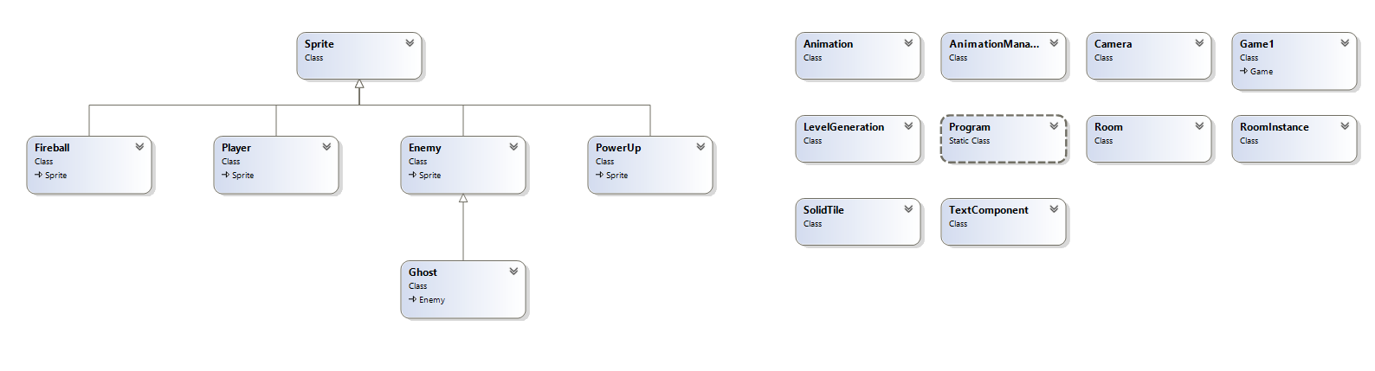
Class Diagram

Slide 7

Procedural Generation Implementation

Slide 8

Procedural Generation Implementation

Slide 9
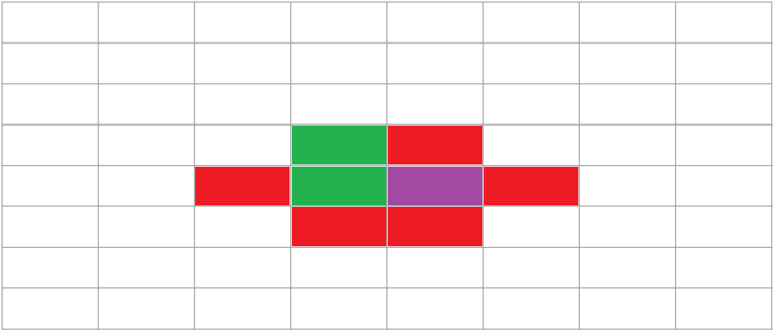
Procedural Generation Implementation

Slide 10
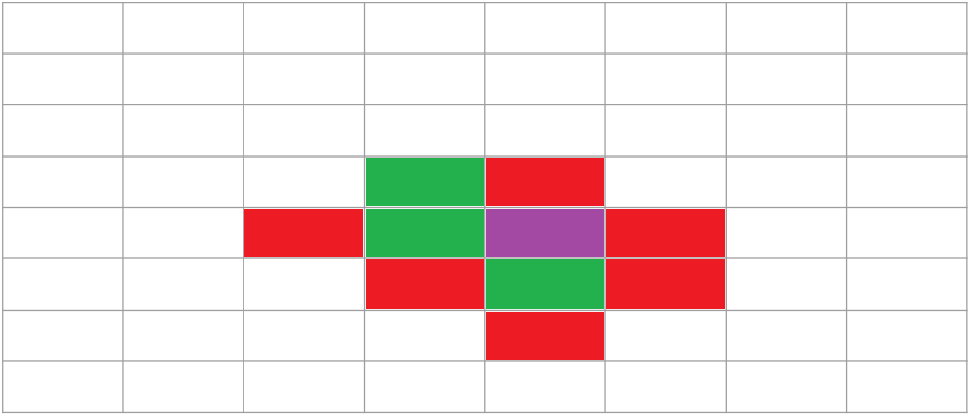
Procedural Generation Implementation

Slide 11
Demo

Slide 12
Questions?

